Slide 1
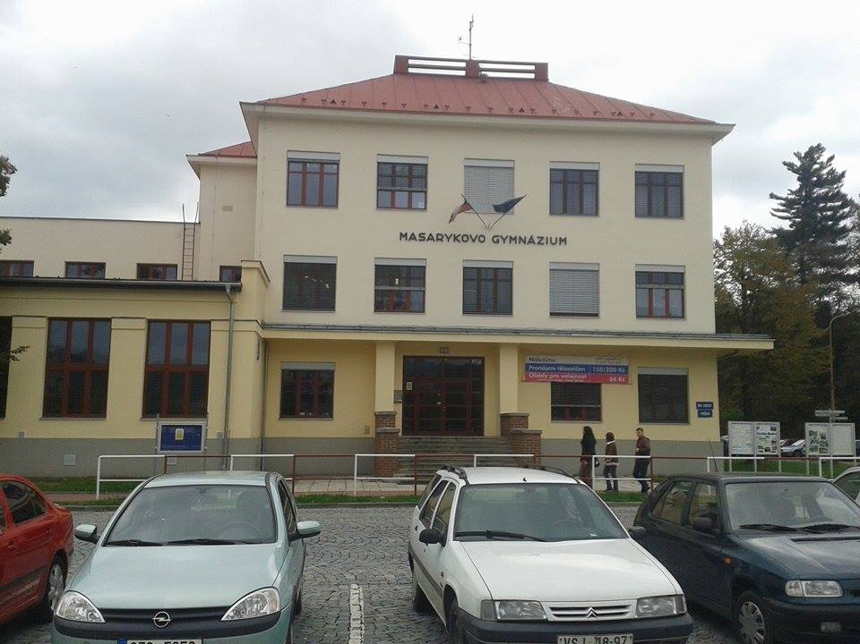
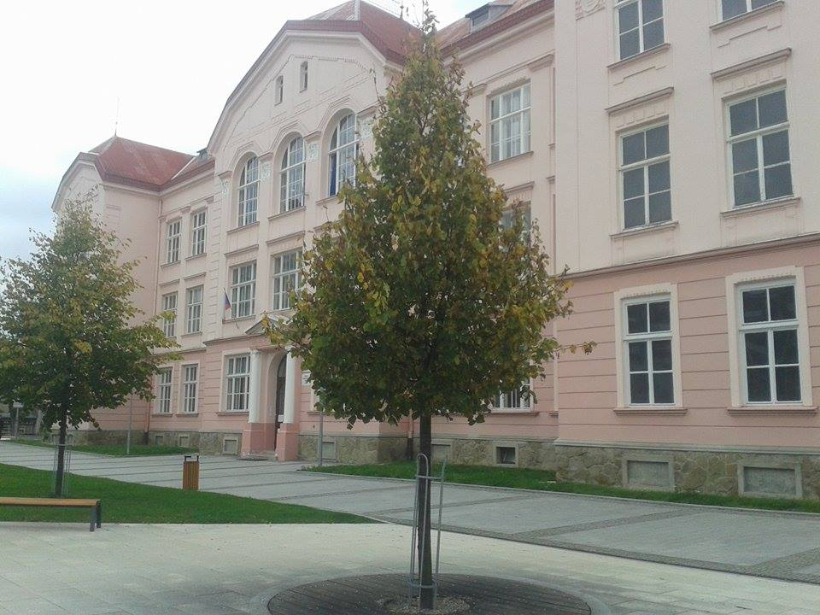
Masarykovo gymnázium Střední zdravotnická škola a Vyšší odborná škola zdravotnická Vsetín

Slide 2
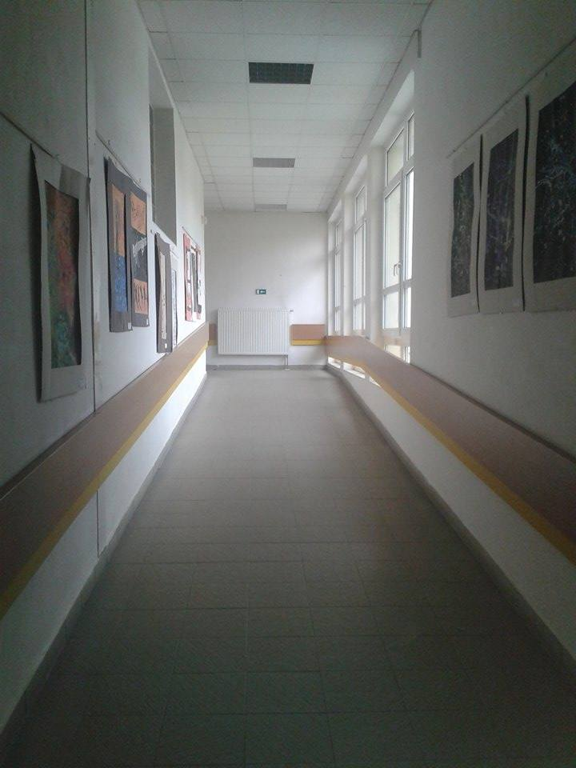
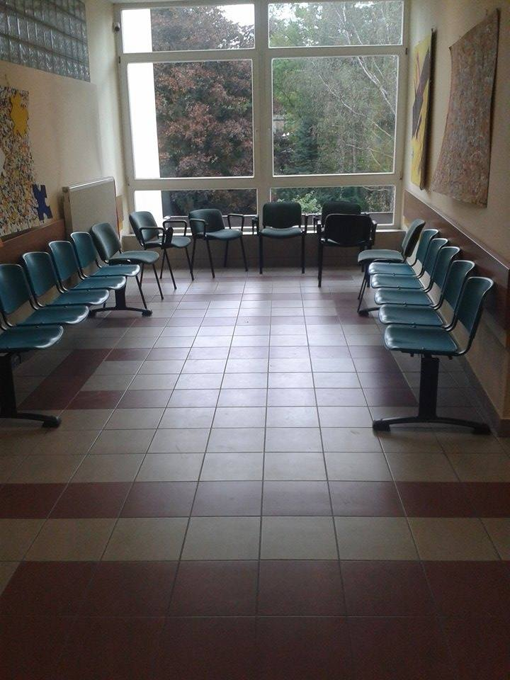
That's how our school looks like. It‘s one of the best hight school in the Zlín Region. There is high quality equipment and modern environment.

Slide 3
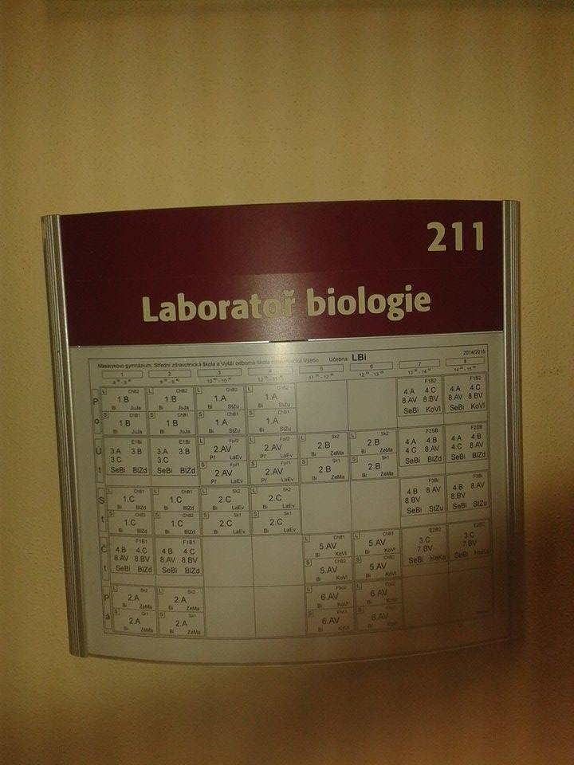
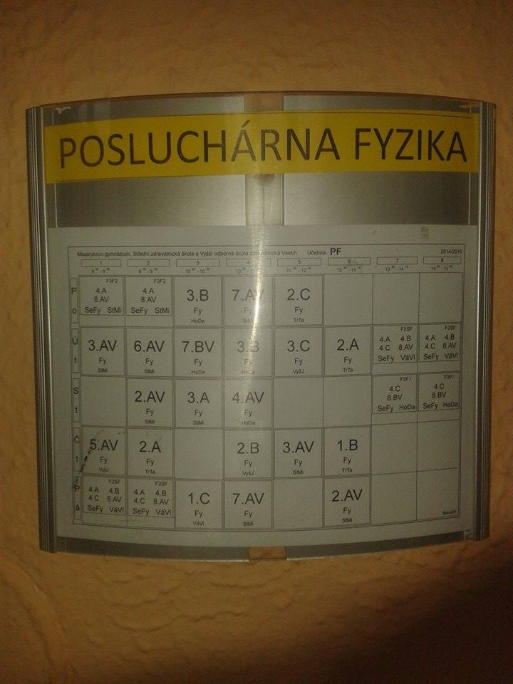
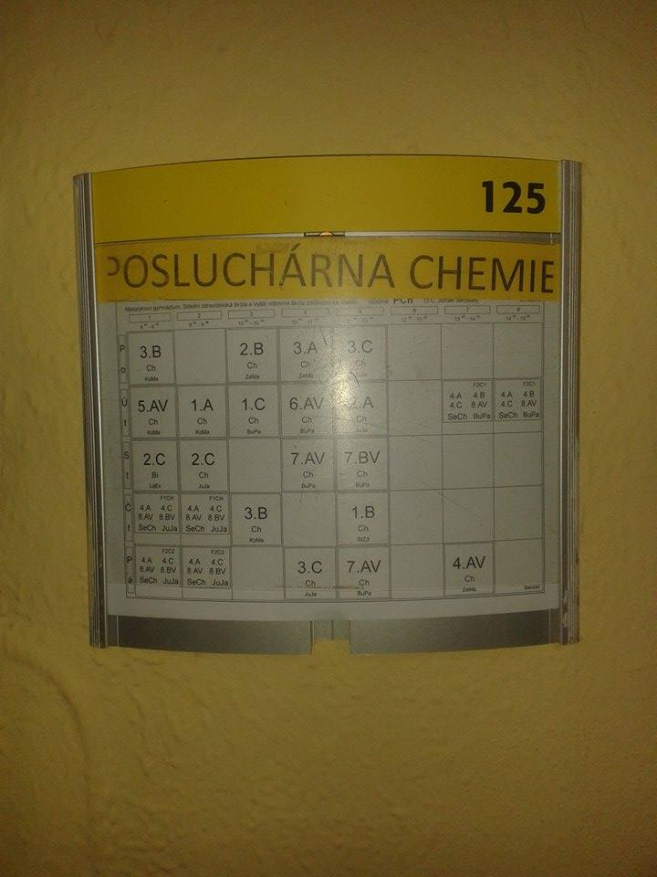
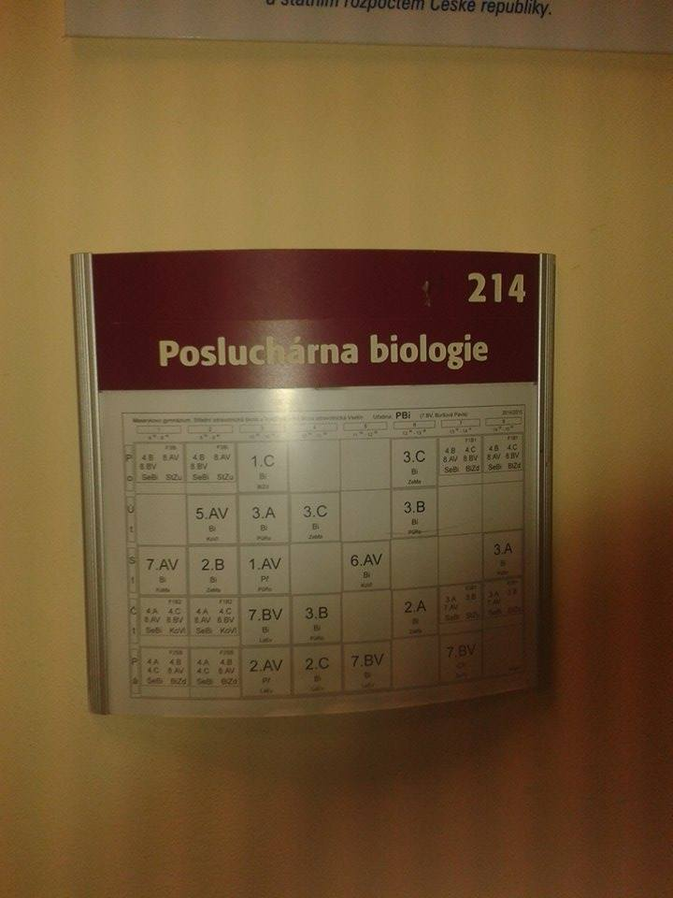
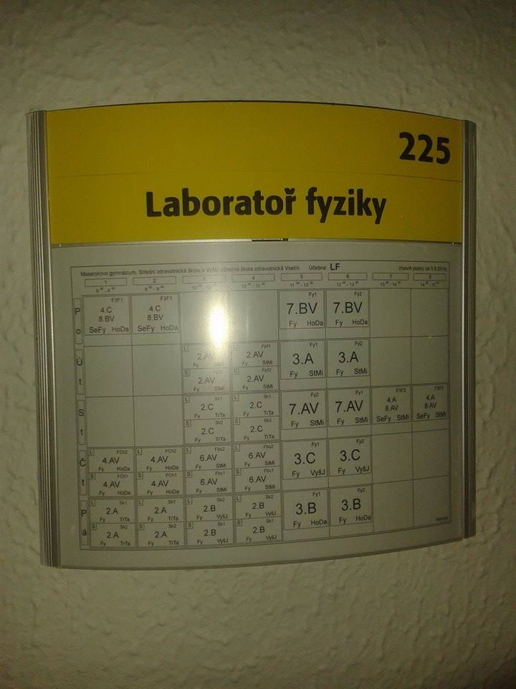
We have really good class rooms, for example biology lecture. There are all biological aids (the human skeleton, description of cells and other stuff). We also have physics lecture Hall and chemistry lecture.

Slide 4
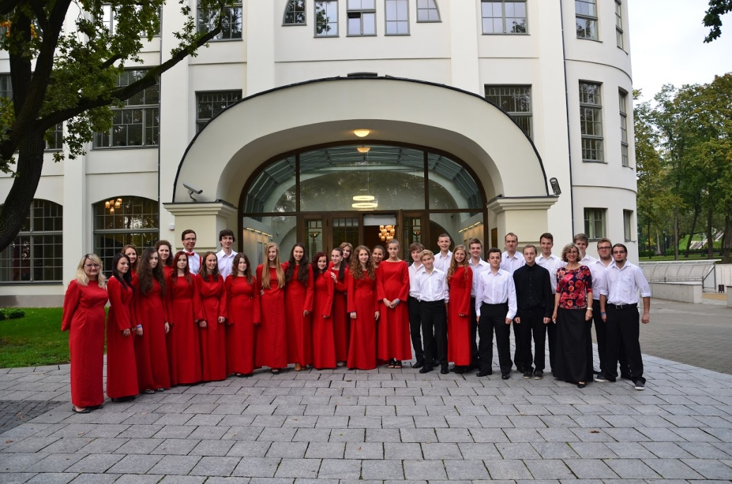
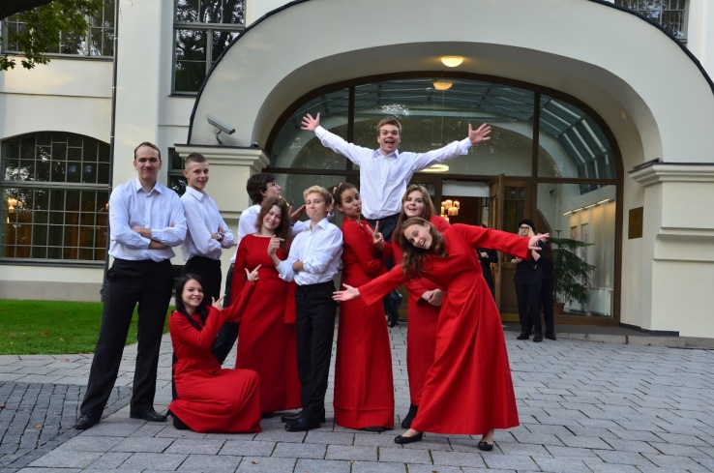
In our school is very popular choir. Under the leadership of mrs. Kaločová is very successful.

Slide 5
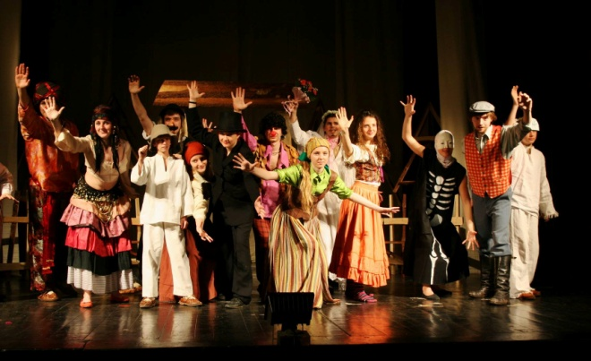
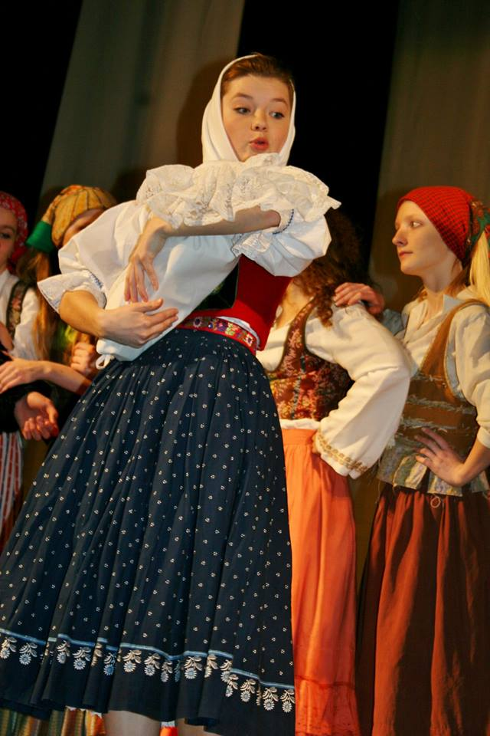
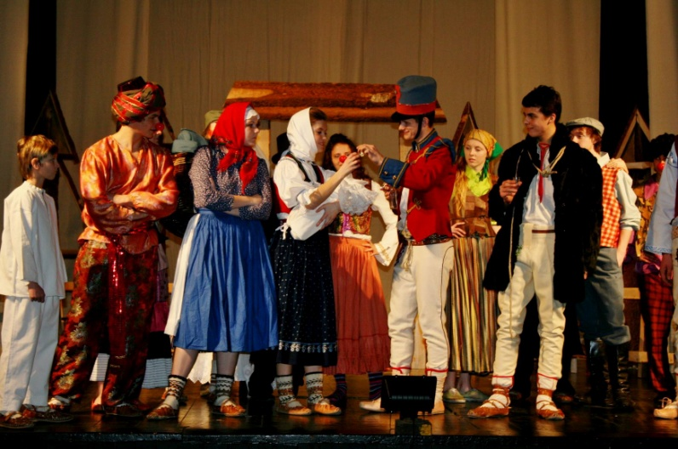
We also have a very successful theater.

Slide 6
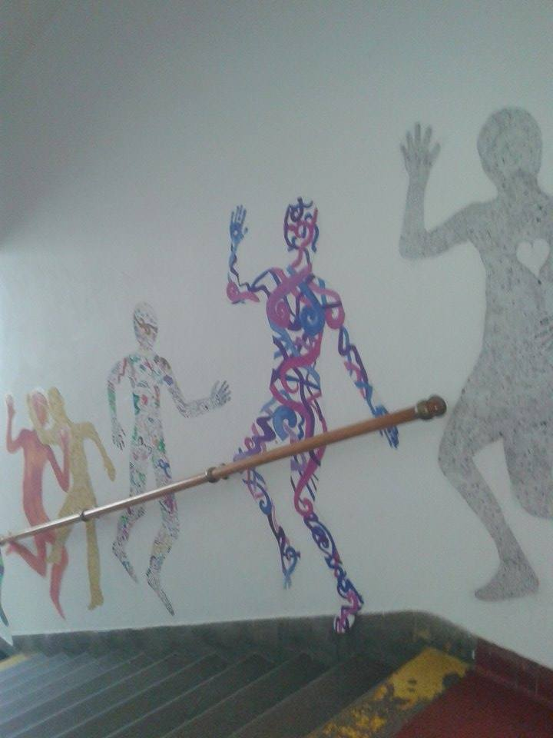
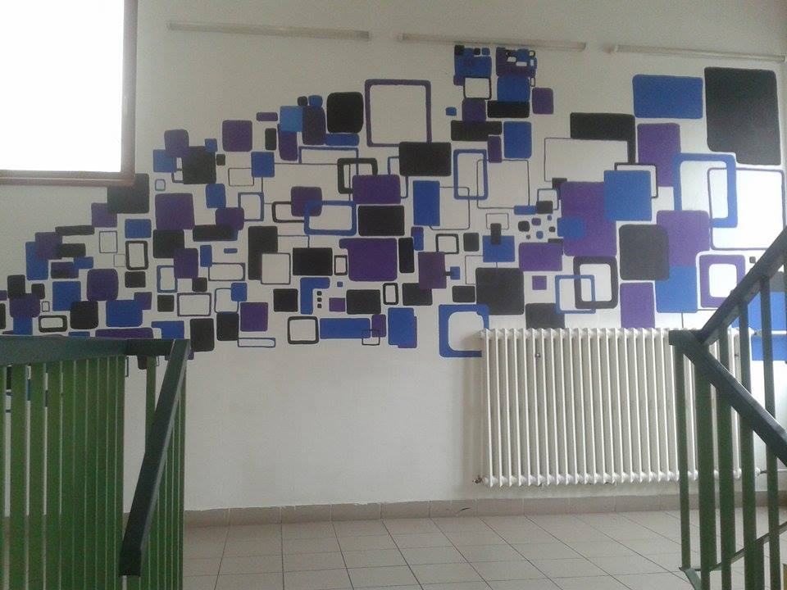
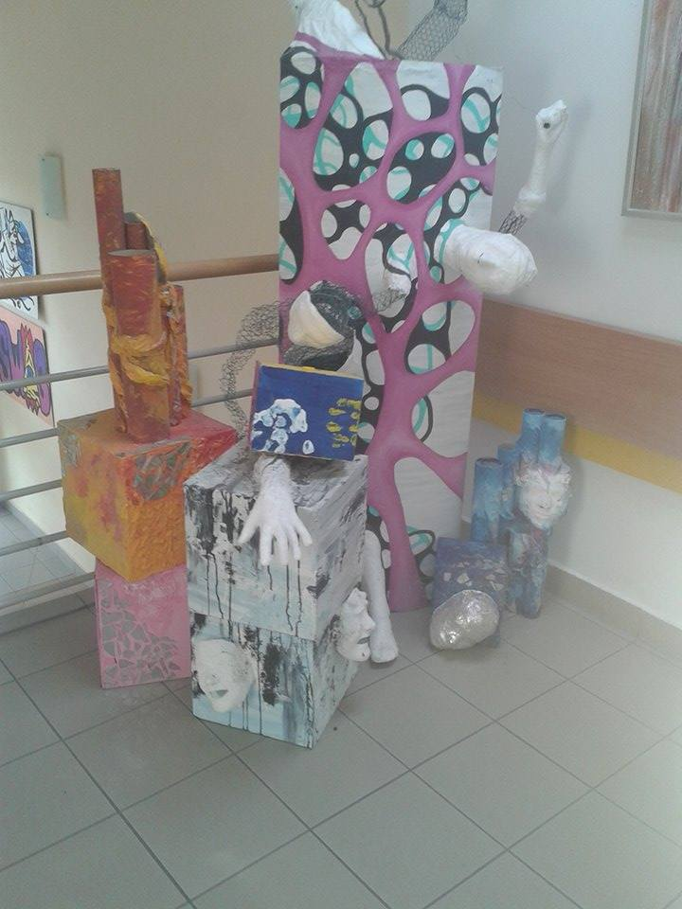
Our school is decorated by creations of our students. A few of them made my classmates. In this school you can just go and draw something on the wall. There is so much creations that no one will know that there is something what is really shouldn‘t be on this wall.

Slide 7
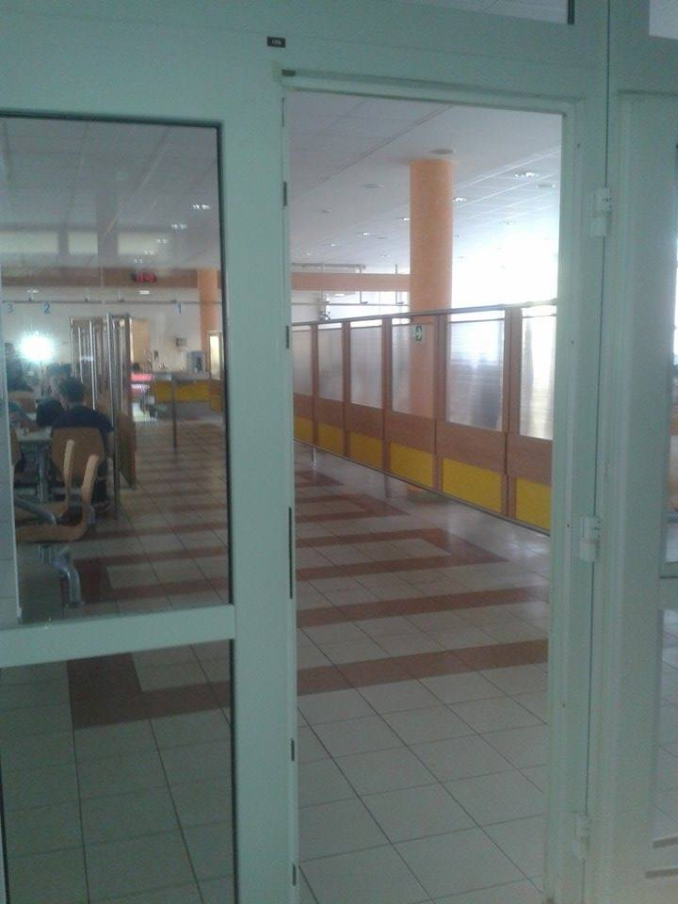
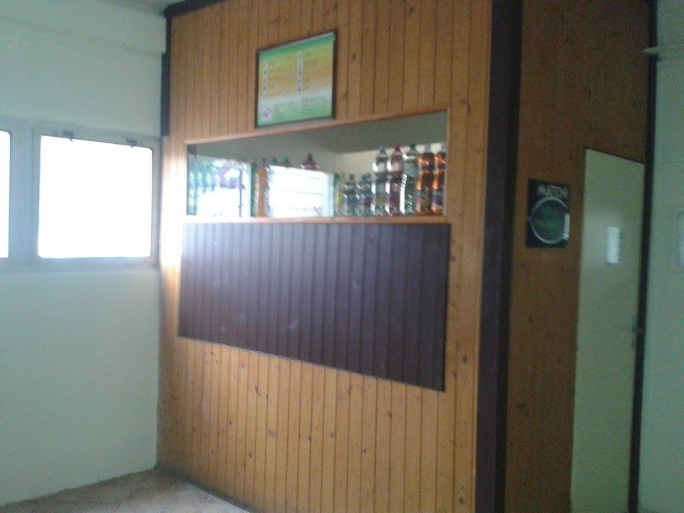
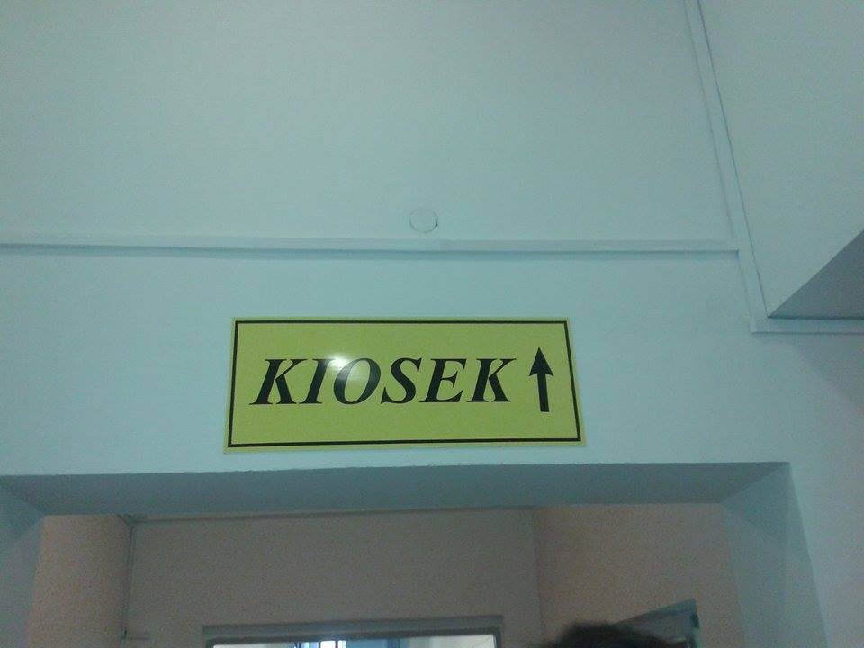
In our school we always have delicious lunch. In case you are hungry during school hours, our cafeteria will save you. There is absolutely everything, so I swear that you won‘t starve.

Slide 8
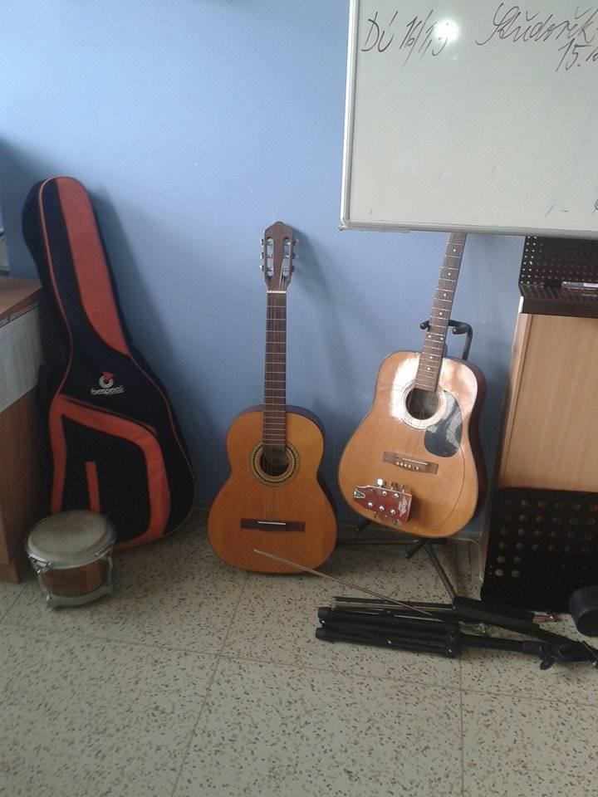
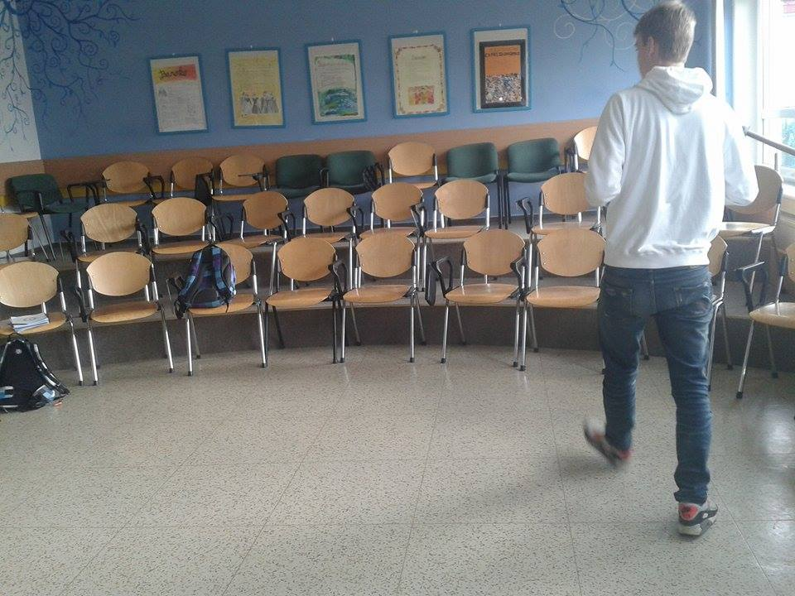
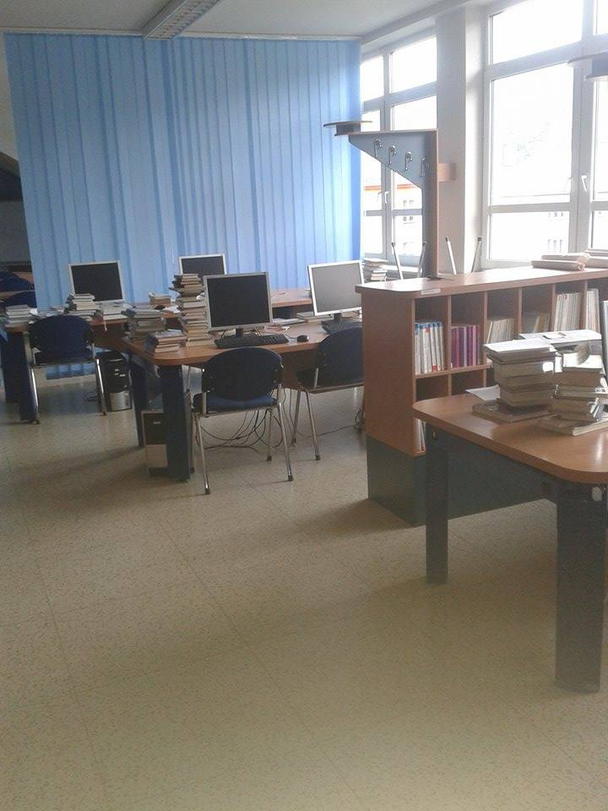
We also have really good music class room. There are three guitars, piano, xylophone and other stuff.

Slide 9
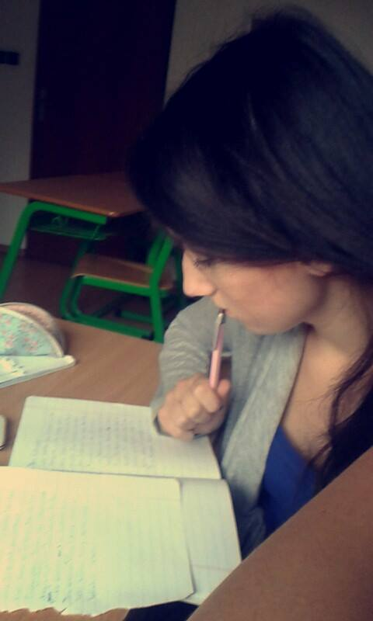
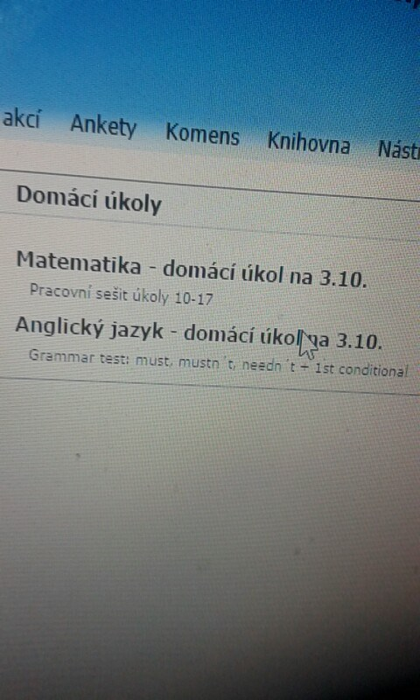
As you can see we have really diligent students. They study all the time. The advantage of our school is that the homeworks and our grades are entered on the school website.

Slide 10
I hope I will see you there in the next school year.
Thank you for your anttention ☺

